Slide 1
Webroot® Security Awareness Training

Slide 2
What is Security Awareness Training?
“
“
Cybercriminals take advantage of your trust, fear, greed, and plain old human error.
Security awareness training teaches you to spot fakes, avoid risks online, and use good cyber-hygiene practices at work and at home.

Slide 3
The world is getting more digital
Business, banking, healthcare, etc. is all online
Crime is following the same trend
Worldwide ransomware attacks
High-profile hacks in the news
Phishing emails are more sophisticated each day
New privacy laws and regulations are being enacted
Many industries require training for compliance
WHY DOES
IT MATTER?

Slide 4
Because the online world is so interconnected, everyone is a target
If just one of your accounts gets breached, criminals can use it to breach others
Criminals may target personal accounts and data to breach corporate ones, and vice versa
Fraud and identity theft doesn’t just affect an individual; it can affect your family, friends, coworkers, and business
WHY SHOULD YOU CARE?

Slide 5
Phishing and spear-phishing attacks
Business email compromise
Social engineering scams
Common malware and ransomware
Fake websites that steal data or infect devices
And much more
WHAT KINDS OF THREATS ARE THERE?

Slide 6


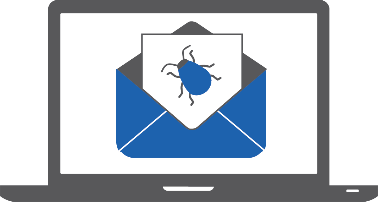
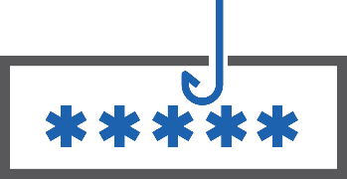
It’s not that dangerous online, though, right?
Nearly 1 in 3 phishing sites uses
HTTPS to appear legitimate¹
1 in 50 URLs is malicious¹
90% of the malware businesses
encounter is delivered via email²
Most breaches involve phishing
and using stolen credentials²
¹ Webroot Inc. “2019 Webroot Threat Report: Mid-Year Update.” (September 2019). ² Verizon. “2019 Data Breach Investigations Report.” (May 2019)

Slide 7
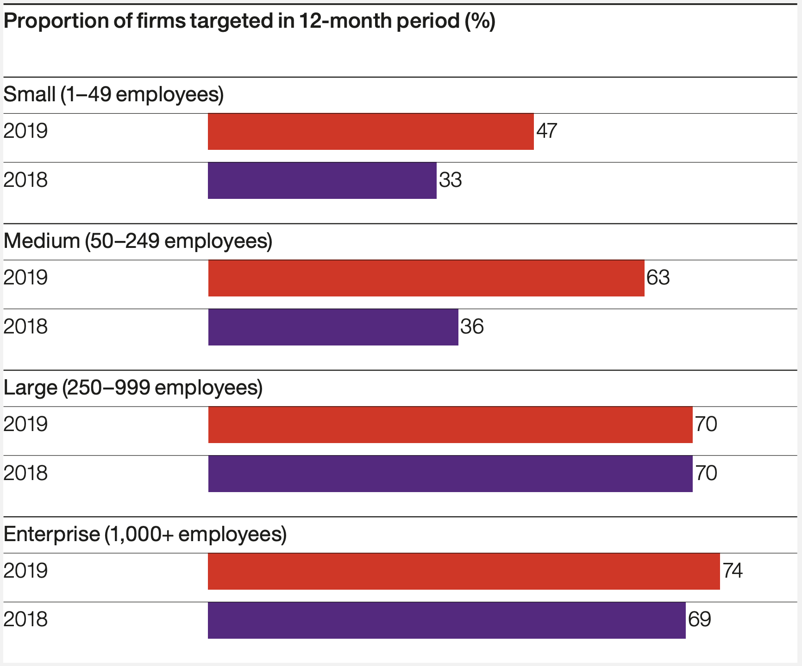
How bad is the risk?
01
Small business face nearly the same level of risk as large/enterprise organizations¹
The average total cost of a data breach is now up to $3.92 million²
02
¹ 2019 Hiscox Cyber Readiness Report
² IBM. “2019 Cost of a Data Breach Report.” (July 2019)

Slide 8
But people know better, right?
35%
49%
67%
40%
of workers who know they’ve been hacked don’t bother to change their passwords afterward¹
of employees admit they click links in messages from unknown senders during work¹
of workers are sure they’ve received at least one phishing email at work¹
Of those who received a phishing email, ~40% didn’t report it
¹ Webroot Inc. “Hook, Line, and Sinker: Why Phishing Attacks Work.” (September 2019)

Slide 9
How does Security Awareness Training help individuals?
It gives you the know-how to stay safe from cybercrime…
AT HOME
AT WORK
Protect your identity and personal data from theft and fraud
Secure your devices against viruses and malware
Keep yourself and your family safe from hackers and spies
Prevent corporate network infections
Stop business email compromise
Keep critical business data safe

Slide 10
How does Security Awareness Training help businesses?
Reduce Breaches
and Infections
Meet Regulatory Requirements
High Return on Security Investment (ROSI)
Improve mindset and behavior
Create a sense of shared security responsibility
Reduce over-reliance on technology
Implement best data governance practices
Meet compliance objectives
Implement affordable cyber-insurance
Fewer infections
Lower clean-up/support costs
Stronger security posture
Higher productivity
High security benefit vs. operational costs

Slide 11















Which regulatory agencies require training?
December 16, 2019
11
Financial services
Health care (HIPAA)
Retail (PCI)
Privacy (GDPR)
Energy (PUC)
1
2
3
4
5

Slide 12
What results should I expect from a training program?
Fewer infections and costs due to user error
Increased profitability,
high ROI
Lower support costs, less time spent remediating
Empowered users who are now the first line of defense
Security-aware culture with
measurable progress
Compliance with best practices and regulations

Slide 13
Does Security Awareness Training actually work?
“
“
After 12 months of ongoing phishing simulations and security awareness training courses, end users are 70% less likely to click through on a phishing message.¹
¹ Webroot Inc. “2019 Webroot Threat Report.” (February 2019)

Slide 14
Can I try before I buy?
Webroot offers free 30-day trials
No risk
No obligation to buy
No credit card required
Visit webroot.com/us/en/business/trials/security-awareness

